Slide 1
Frictionless sequence optimization with Pulseq-zero
Jonathan Endres¹, Moritz Zaiss^{1,2}
¹ Institute of Neuroradiology, Universitätsklinikum Erlangen, Friedrich-Alexander-Universität Erlangen-Nürnberg, Erlangen, Germany
² Department Artificial Intelligence in Biomedical Engineering, Friedrich-Alexander-Universität Erlangen-Nürnberg, Erlangen, Germany

Slide 2
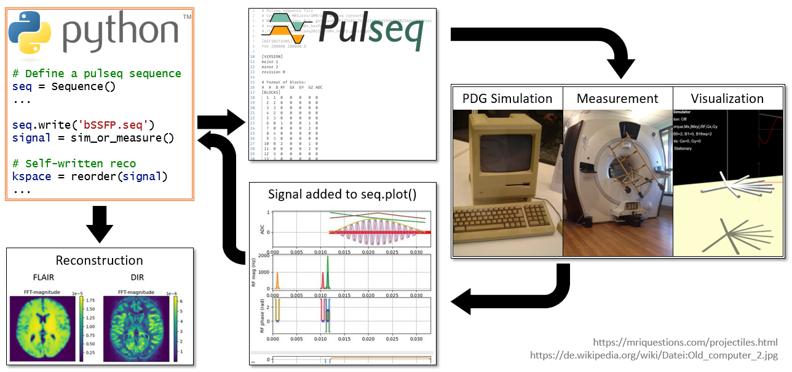
Motivation – current application of Pulseq
Parameters completely lost in .seq file
Build sequence based on any parameter:
Echo timing
RF phase cycling
…

Slide 3
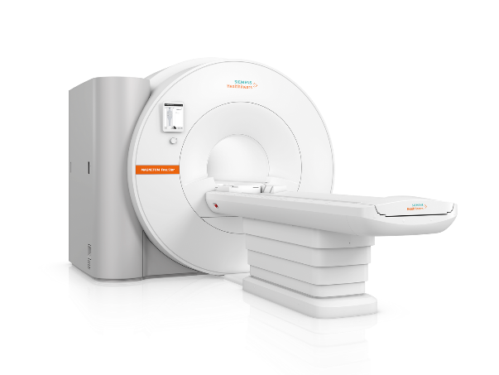

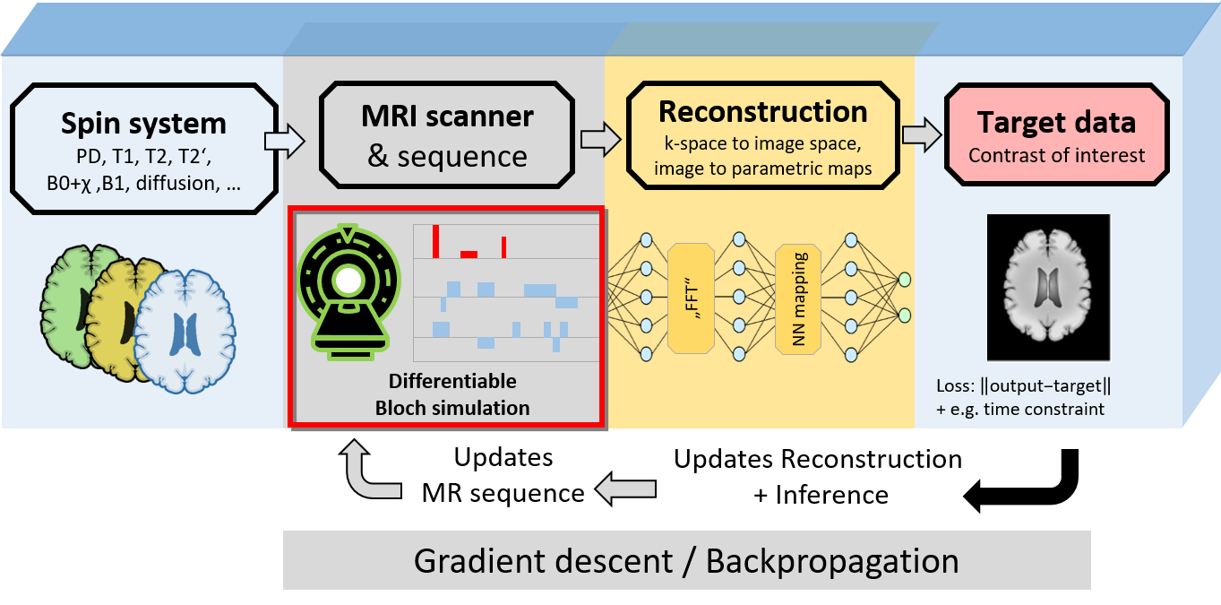
Goal – Allow optimization of PyPulseq sequences
Insert PyPulseq into MR-zero…
*
…without compromising its use for measurement
Schematic of the MR-zero framework. Image courtesy M. Zaiss
*application is vendor agnostic, used for displaying purposes only https://www.siemens-healthineers.com/en-us/magnetic-resonance-imaging

Slide 4
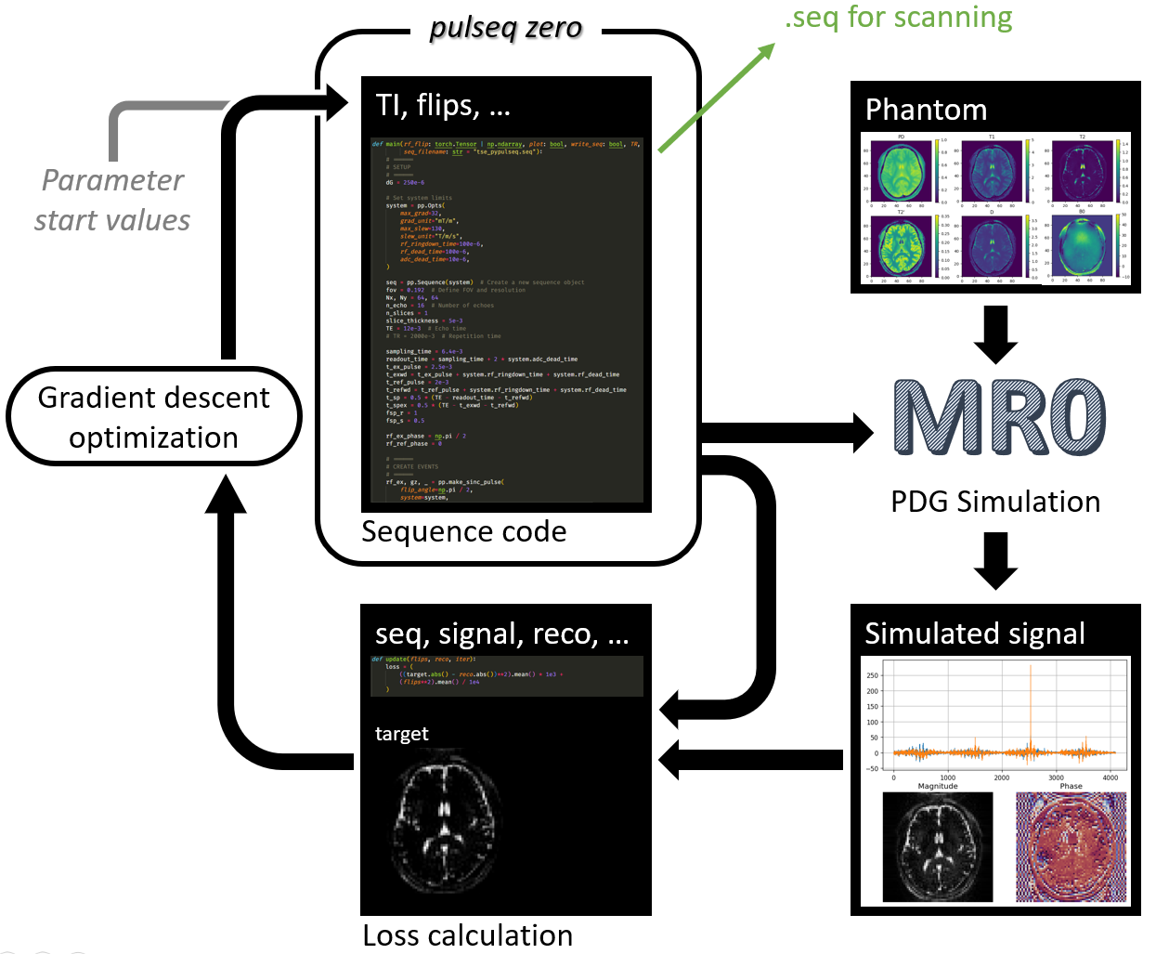
Approach

Slide 5


Follow along:
https://mrzero-core. readthedocs.io/
Interactive DESC Notebook

Slide 6
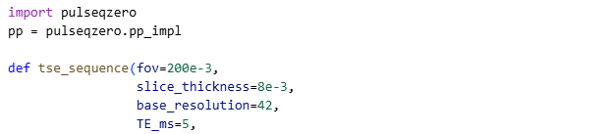
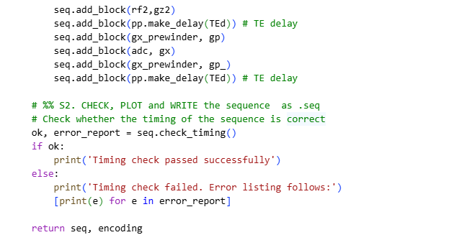
Write the sequence with pulseq-zero
…

Slide 7
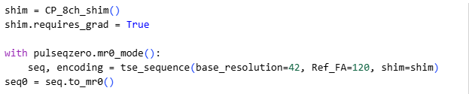
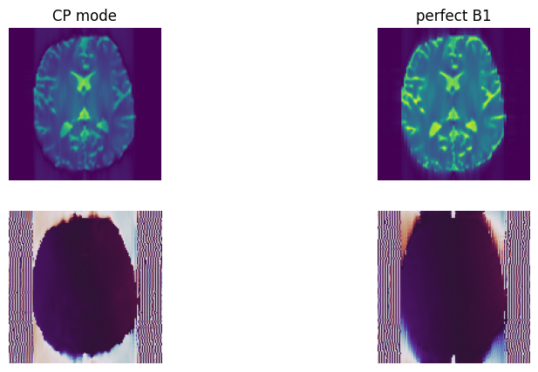
Convert to MR-zero

Slide 8
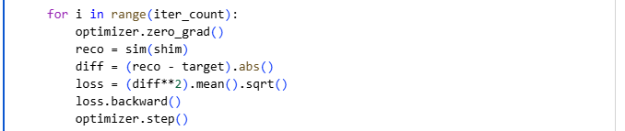
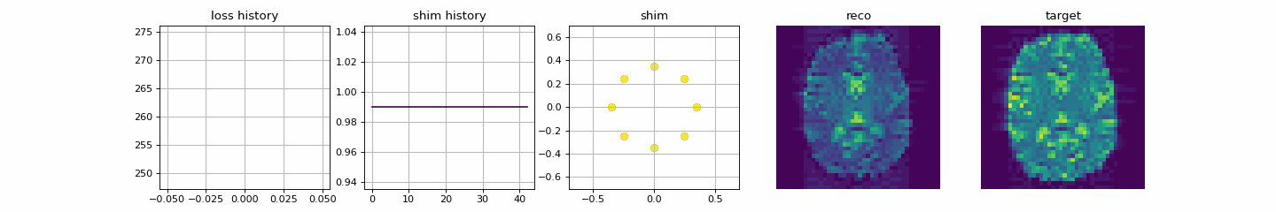
Optimize!

Slide 9
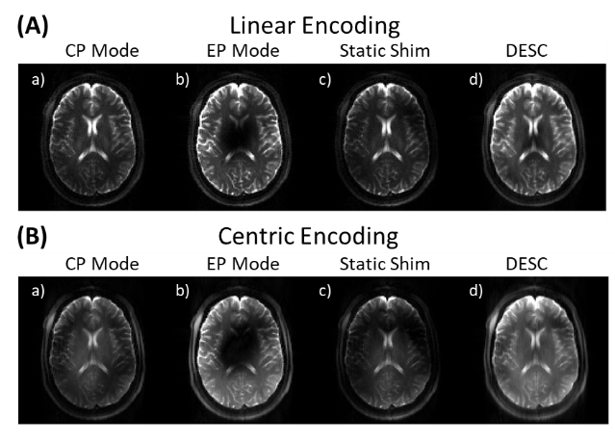
Measure as .seq

